Slide 1

Saline level Monitoring System Using IoT
by
R. Pallavi
Roll No. 204G1A0569
M. Sai Kiran
Roll No. 204G1A0586
C. Vamsi
Roll No. 214G5A0512
G. Sreekar Vamsi Krishna
Roll No. 204G1A05A1
Under the guidance of
Mr. P. Shajahan M.Tech.
Assistant Professor
Department of Computer Science and Engineering
Srinivasa Ramanujan Institute of Technology
(Autonomus)
2023 - 2024

Slide 2

Contents
Abstract
Problem statement
Objectives of Project
Literature survey for first objective
Literature survey for second objective
Proposed Work -(Methods to be followed for proposed system)
References
GitHub Link
Queries

Slide 3
Abstract
Saline is a popular intravenous therapy for critically ill patients. Proper monitoring of saline bottle levels and timely needle removal is crucial for patient safety and preventing blood flow into saline bottle. Negligence can lead to serious consequences and even death. Thus new health monitoring systems have been developed to work without human interaction and are affordable, suitable for both rural and urban areas. These systems help nurses monitor saline levels in patients' rooms without physically present. Automatic saline level monitoring uses sensors to detect if the bottle is full or if there is an issue. These sensors accurately measure saline dripping speed, indicating if the bottle is running out of liquid. When the saline level drops, the system alerts the nurse, reducing the need for constant monitoring.

Slide 4
Problem Statement
Blood rushes back to saline bottle after saline finishes due to pressure difference, potentially causing reverse flow from veins.
It is important to monitor saline level and change the saline bottle as soon as it falls below the threshold level and to give proper medication timely.
In order to overcome these issues, with the help of an automatic saline level monitoring consists of IR sensors which are used to determine the status of liquid in the bottle whether it is normal or warning status

Slide 5
Objectives of Project
The system should provide accurate and real time monitoring of saline levels in saline bottle. It should be capable of sending alerts or notifications when the saline levels drop below a certain threshold, ensuring timely refilling.
The system will look at all the information it collects about saline levels. It will use this information to figure out how the saline is being used over time. This helps people in charge make better decisions about when and how much saline to refill.

Slide 6
Literature survey for first objective
The epidemic growth of wireless technology and mobile services in this epoch is creating a great impact on our life style. Some recent efforts have been taken to utilize these technologies in medical industry.
In this field, ECG sensor based advanced wireless patient monitoring system concept is a new unique idea. The saline level is indicated by LCD. The outputs are displayed through mobile application.

Slide 7
Literature survey for second objective
The system in a rural public hospital can accurately check saline droplet status in each patient's bed by installing measuring modules. This allows nurses to accurately monitor the droplet rate, remaining time, and saline droplet statuses on a computer.
The system includes four statuses: Normal (green light), Warning (yellow light), Error (red light), and Change New Bag (blue light). The system ensures accurate monitoring and management of patients saline droplet level.

Slide 8
Proposed System
To overcome the difficulty of the existing system, we will monitor the saline level using internet and will trigger a notification or alarm when the saline level goes down beyond threshold level.
The proposed system uses IR sensor, NodeMCU, Microcontroller.

Slide 9
References
[1].P. Kalaivani, T. Thamaraiselvi, P. Sindhuja and G. Vegha "Saline Level Monitoring System Using Arduino UNO Processor"Asian Journal of Ap- plied Science and Technology (AJAST) Volume 1,March 2017.
[2].Pattarakamon Rangsee, Paweena Suebsombut, Phakphoom Boonyanant "Low-Cost Saline Droplet Measurement System using for Common Patient in Rural Public Hospital". The 4th Joint International Conference on Information and Communication Technology, Electronic and Electrical Engineering (JICTEE) 978-1-4799-3855-1/14 2014.

Slide 10
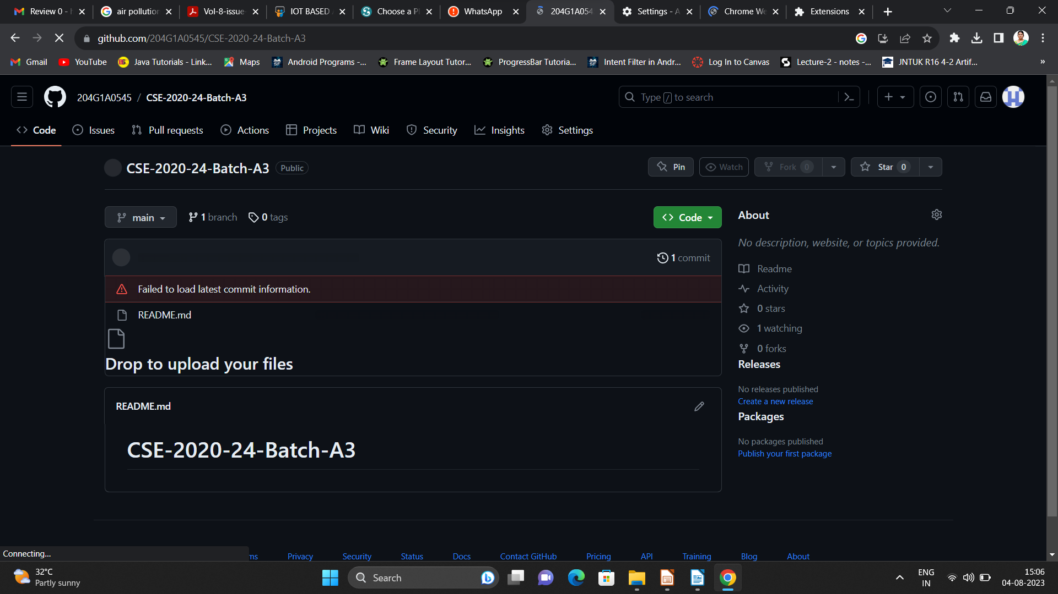
Git Hub Dashboards of each student

Slide 11
Any Queries?

